Slide 1
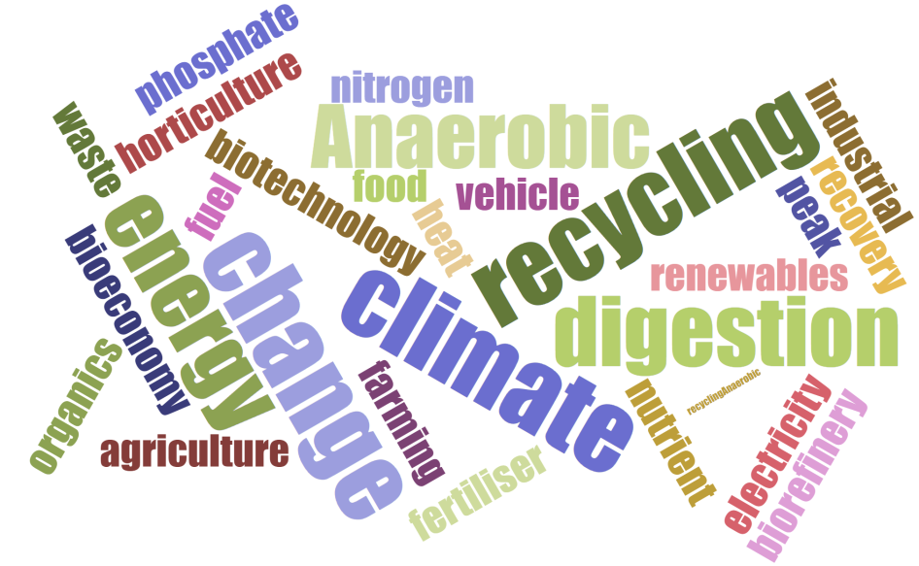
Outreach and the circular bio-economy
…or reaching people who didn’t know they cared
Circular Bioeconomy Group
Peru Showcase, Nov 17

Slide 2


What we are doing…
We are a team of researchers and practitioners who aim to introduce the widest variety of people to the concept of the circular bio-economy and to provide activities which stimulate learning, questions and discussion on industrial practice, policy and research.

Slide 3





Who is involved and why?
University of Southampton Public Engagement in Research Unit – committed to sharing knowledge, resources and skills with the public, and to listening to and learning from the expertise and insight of these different communities. (See YouTube video here).
Bioenergy and Organic Resources Research Group, University of Southampton – a large and diverse research group that is internationally recognised for work on AD, with an increasing focus on new biotechnology and biorefinery applications. (Social media and group info).
The Anaerobic Digestion Network, one of 13 free-to-join Networks in Industrial Biotechnology and Bioenergy who facilitate interactions between academia and industry through the provision of workshops, research funding and other networking opportunities.
Supergen Bioenergy Hub, who are interested in the role of AD and its role within the context of the wider bioenergy landscape.
Fiberight and Methanogen UK, industrial partners who wish to publicise what they do as companies, increase company recognition and recognition of their respective technologies.

Slide 4
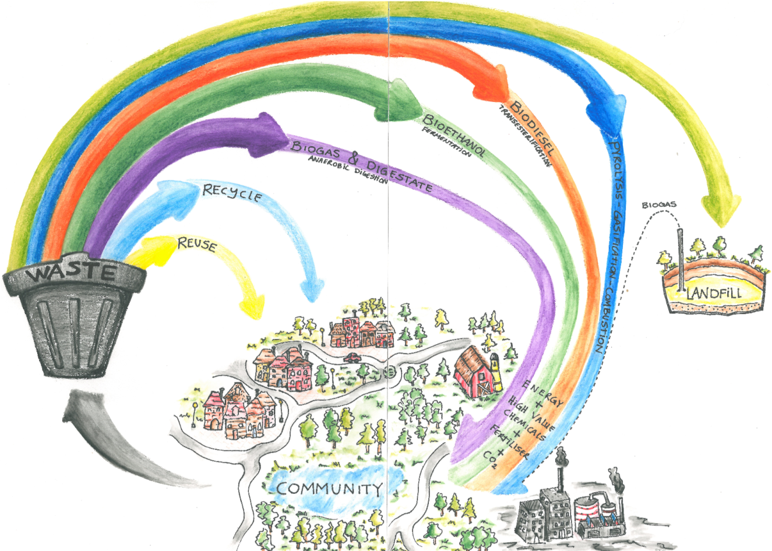
The news media is, for the most part, the bringers of bad news…and it’s not entirely the media’s fault; bad news gets higher ratings and sells more papers than good news.
Challenges…
Putting across a clear message
about a complex system or complex research:
In an interesting and engaging way (the ‘hook’)
In a way the audience can understand (the ‘story’)
In a way that might even create behavioural change
Responding to ‘disaster stories’
NIMBY’s / Perceptions
Measuring ‘impact’ –
are we really reaching people?
Knowledge across a wide
field

Slide 5
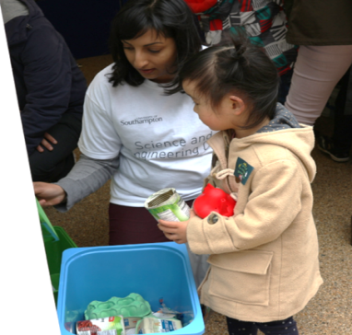
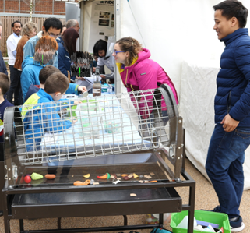
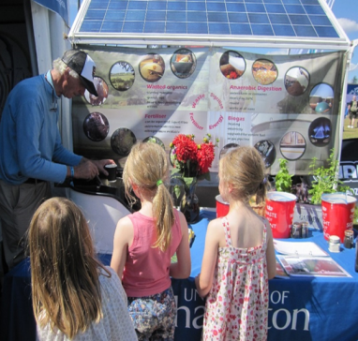

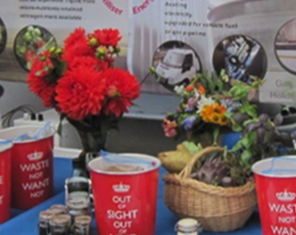
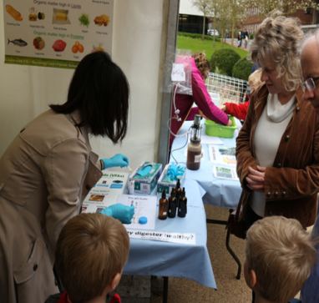
The bioeconomy story …
Recycling
Sorting
(The Rubbish Game)
AD Treatment
(and popcorn)
The HOOK!
Products
(food, fertiliser, energy)
Monitoring
(aka Show & Smell)

Slide 6
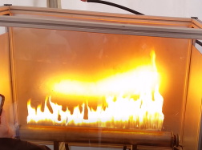
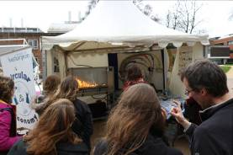
The Hook…a Rubens Tube
Funded by PERU
Designed and built at the University
(Luke Muscutt – Outreach Guru)
Learning curve!
How did we do?
In action on: https://youtu.be/LTTHUiL-FRo

Slide 7
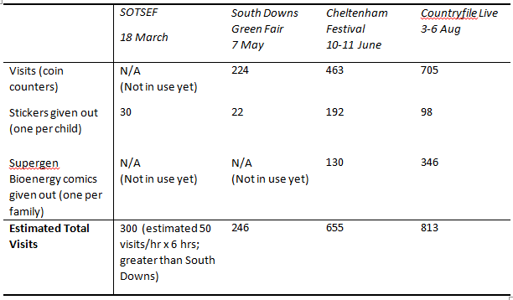

Impact
Why is there so much food waste?
That’s fascinating!
Why doesn’t everybody do this?
You could make 3D printed bioplastics from food waste?
We have separate food waste collection – does it go to landfill?
Why is rubbish collected differently everywhere in the UK?
This is the best thing at the festival!
I didn’t know you could do THAT!

Slide 8

Outreach benefits…
Inform the general public on the potential of waste as a resource
Increase the percentage of the population who are aware of industrial biotechnology and the role it has to play in the sustainability of the planet
Potentially engage with stakeholders and public parties could help to drive the direction of research or initiate internal discussion on the public perception of such technologies which could lead to new ideas/methodologies being proposed in grants
Vehicle for quantified ‘impact’ as an output from grant funding
Network with other researchers involved in outreach to see whether there are potential synergies and learn about their research
For our researchers: Improvement in confidence, knowledge, contextualisation of their research and communication skills (as well as cultural knowledge!)
Enjoyment related to spreading the message and passion behind what we do

Slide 9
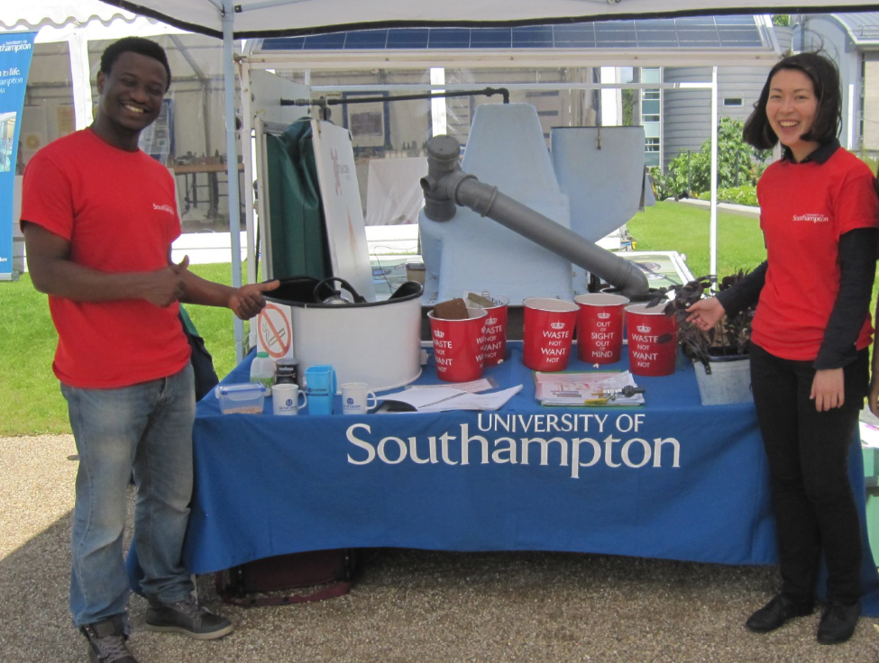
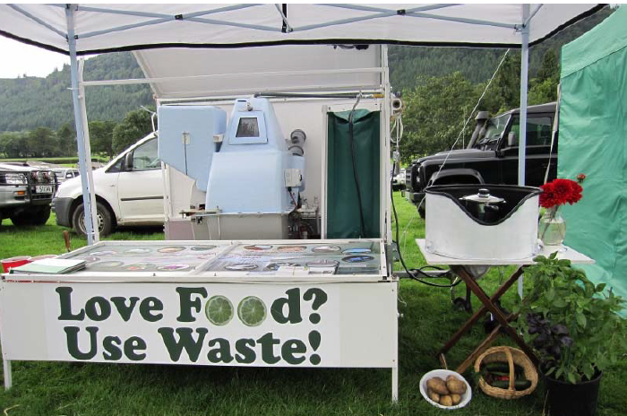
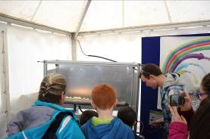
Thank you

